Slide 1
Screen Time Analysis and Visualization Using Power BI
Name : M Mohammed Salman
College : B S Abdur Rahman Crescent Institute of Science and Technology
Department : B.Tech Artificial Intelligence and Data Science
Year : 4
Semester : 7

Slide 2
Problem Statement
Screen time among young people is rising rapidly due to the widespread use of digital devices for education, entertainment, and communication.
Excessive or poorly managed screen usage is linked to health risks (like poor sleep, eye strain, and anxiety), but data-driven insights on device-wise, age-wise, and gender-wise patterns are often missing.
This project aims to provide detailed analytical dashboards highlighting these patterns to support better awareness and targeted interventions.

Slide 3
Objectives
To explore the distribution of screen time across age, gender, location, and device types.
To identify key factors (device, age group, location) associated with high or risky screen time usage.
To visualize health impacts correlated with screen habits.
To produce actionable dashboards and extract insights for parents, educators, and policymakers.

Slide 4
Methodology
Data Acquisition: Collected raw dataset (“indian-kids-screentime-2025.csv”) containing participant demographics, screen time usage, device preferences, and health impacts.
Data Cleaning & Engineering:
  Cleaned and standardized categorical/numeric fields, handled duplicates and missing data in Power Query.
  Created new features (e.g., screen time bins, exceeded recommendations).
Visualization & Analysis:
  Used Power BI, added multiple dashboards with bar/pie/line/matrix charts.
  Applied dynamic theming (light/dark) using a color mapping table and DAX.
  Created interactive slicers for age, gender, device, and location.

Slide 5
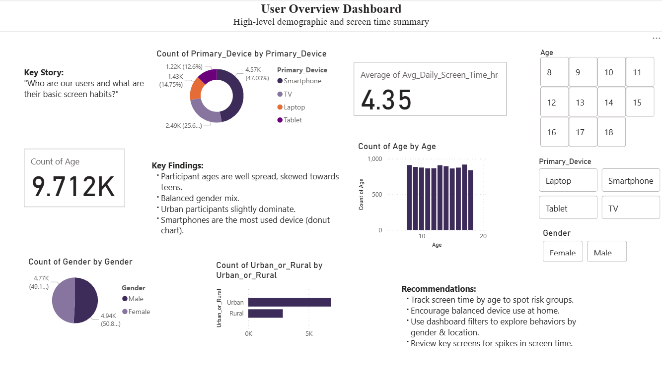
Results / Outputs - User Overview Dashboard

Slide 6
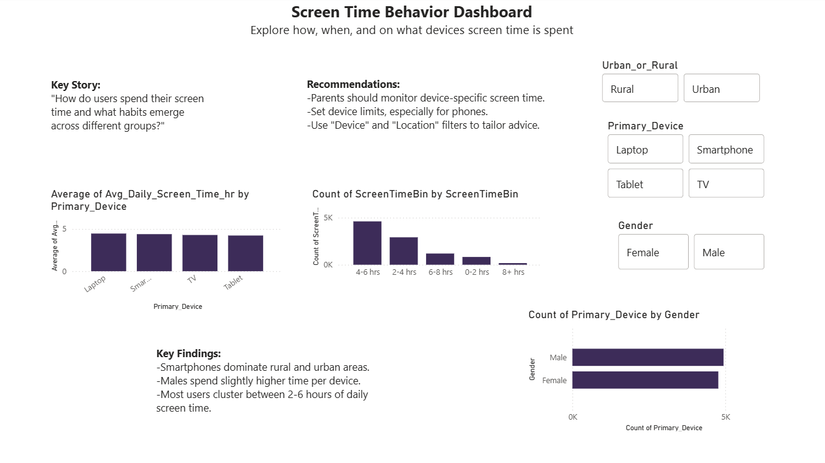
Results / Outputs - Screen Time Behavior Dashboard

Slide 7
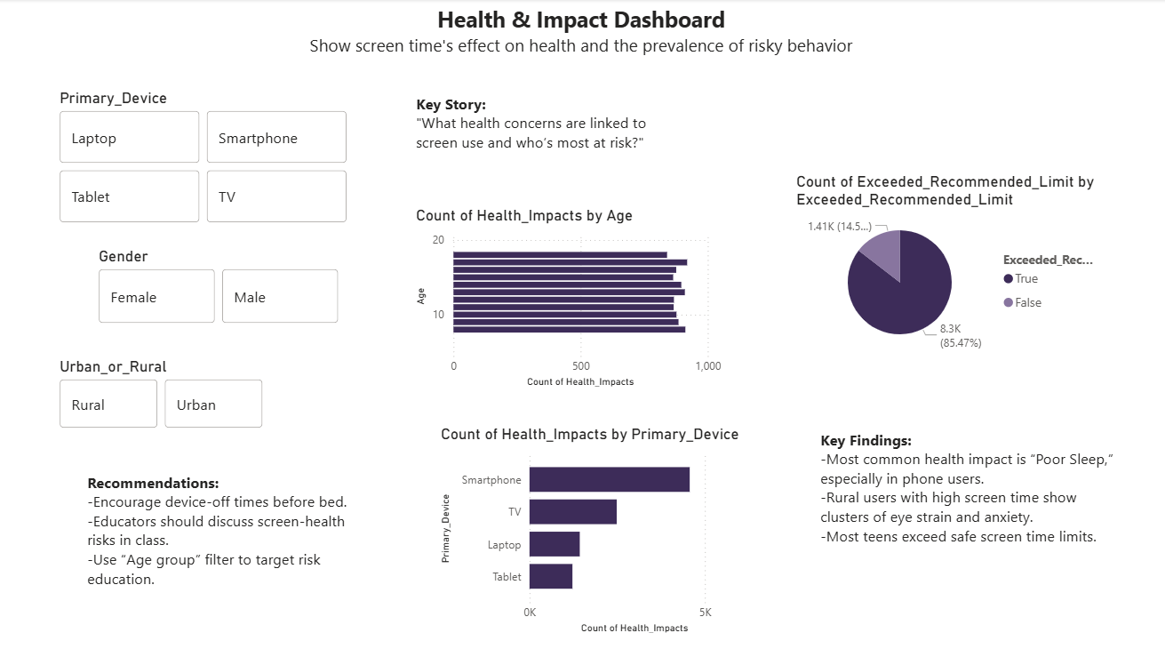
Results / Outputs - Health & Impact Dashboard

Slide 8
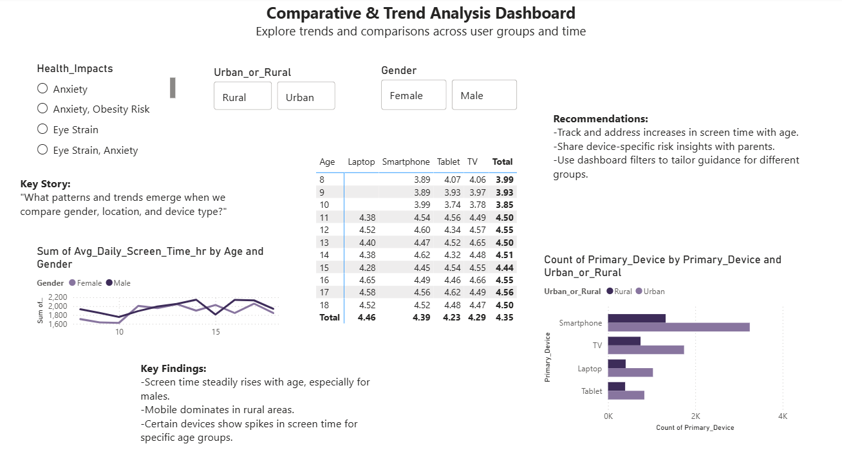
Results / Outputs - Trend & Comparative Dashboard

Slide 9
Conclusion
Device type, age, and location significantly shape screen habits.
Majority of users, especially older teens, exceed recommended screen time—often on smartphones.
Health impacts (notably sleep and vision issues) frequently coincide with high mobile usage.
The interactive dashboards empower parents/educators to pinpoint risks and tailor interventions.

Slide 10
Future Scope
Expand analysis to include app-level usage, content types, and time-of-day patterns.
Integrate longitudinal tracking to assess the effects of screen time reduction initiatives.
Collaborate with schools/parents for intervention pilots and feedback loops.
Extend dashboard interactivity and accessibility for broader stakeholders.

Slide 11
References
Dataset: https://www.kaggle.com/datasets/ankushpanday2/indian-kids-screentime-2025
Microsoft Power BI Documentation

Slide 12
Acknowledgment
Thanks to mentors, project supervisors, and fellow contributors.
Data donors/participants whose inputs made this analysis possible.
Appreciation for guidance and learning resources from Power BI forums and documentation.

Slide 13
Thank You

